Slide 1


Slide 2


Slide 3


Slide 4









RICARDO PUMA ALVAREZ
https://www.linkedin.com/in/rpumaalvarez/
+
Academia
Industria
Academia
Academia + Industria
Industria

Slide 5

CONVERSATORIO
Look-alike modeling based on instance-based learning

Slide 6

INDICE
Problema Look-alike
Paradigma Instance-based
Conceptos importantes
Desafios look-alike
Propuestas de mejora

Slide 7
LOOK-ALIKE MODELING

Slide 8
LOOK-ALIKE MODELING
https://www.facebook.com/business/help/465262276878947

Slide 9
LOOK-ALIKE MODELING
Alternativas
1) Universo como clase negativa
2) Target en base a feedback de campañas pasadas
3) Similitud (instance-based)

Slide 10
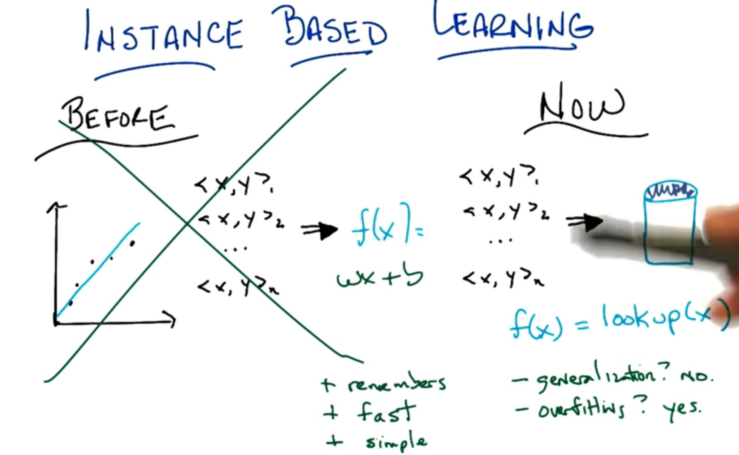
https://www.youtube.com/watch?v=yZBKzXjSg1k

Slide 11
LOOK-ALIKE MODELING: Conceptos importantes

Slide 12
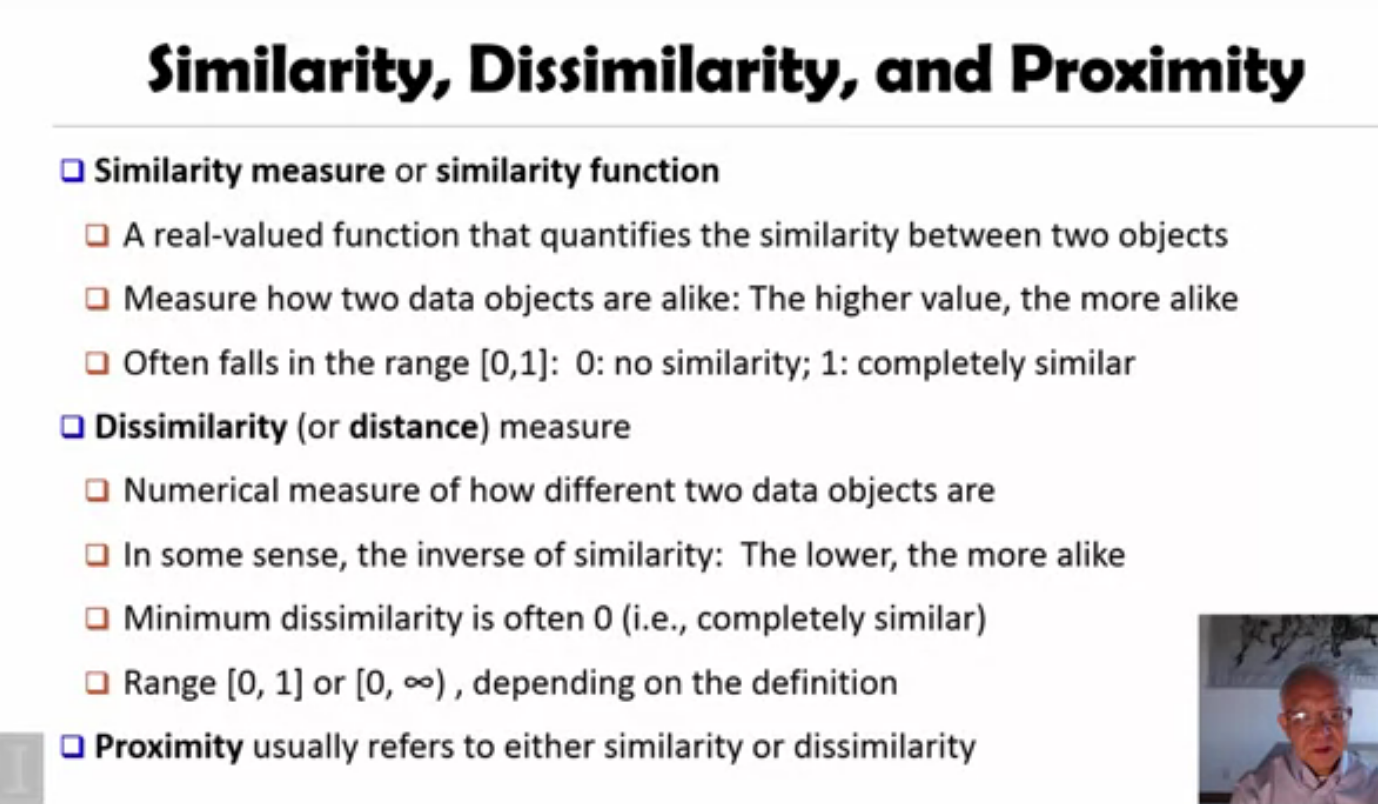
https://es.coursera.org/lecture/cluster-analysis/2-1-basic-concepts-measuring-similarity-between-objects-kjQji

Slide 13
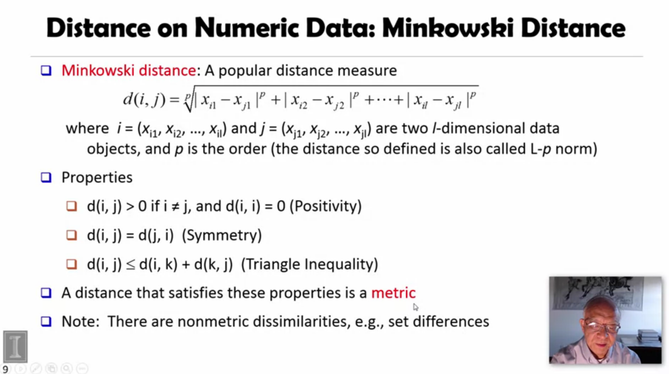

Slide 14
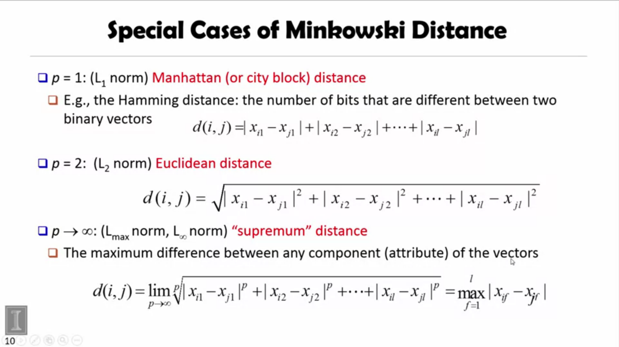

Slide 15
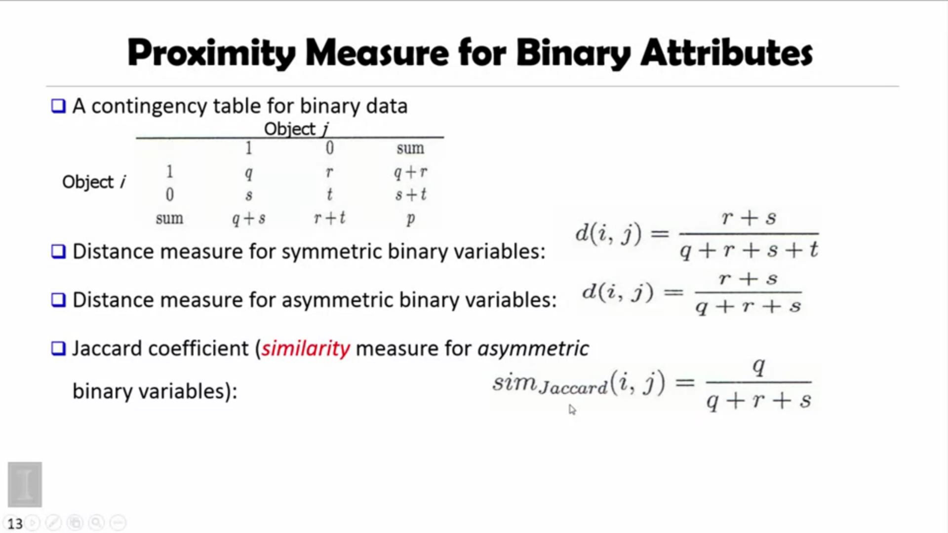

Slide 16
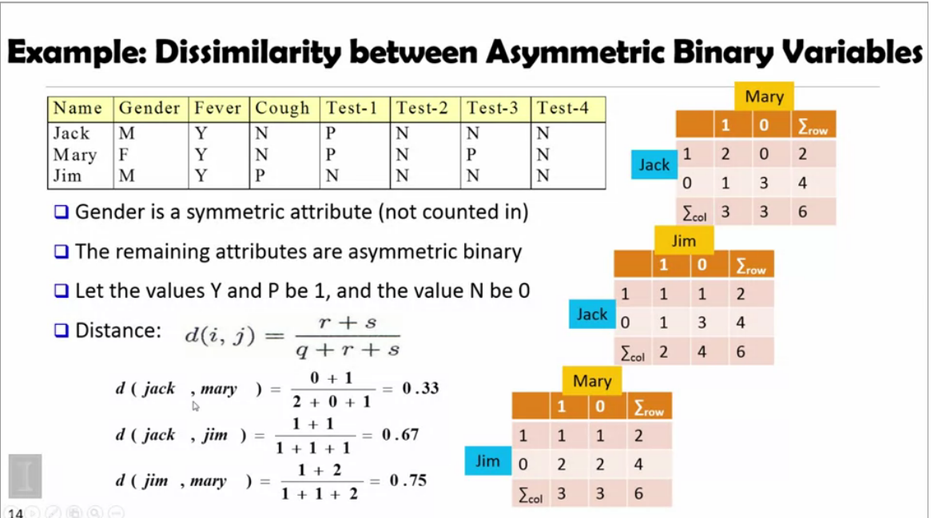

Slide 17
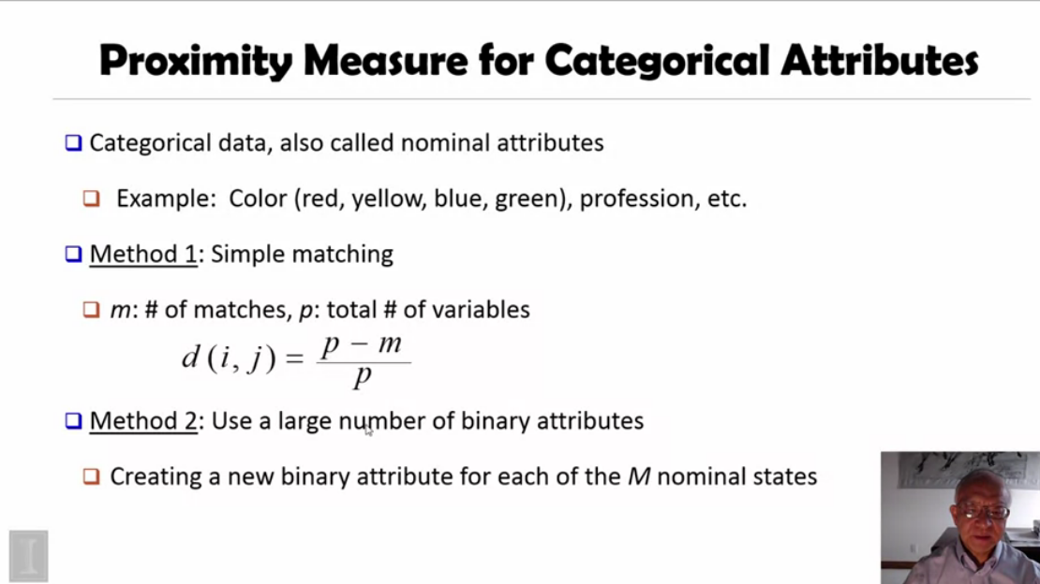

Slide 18
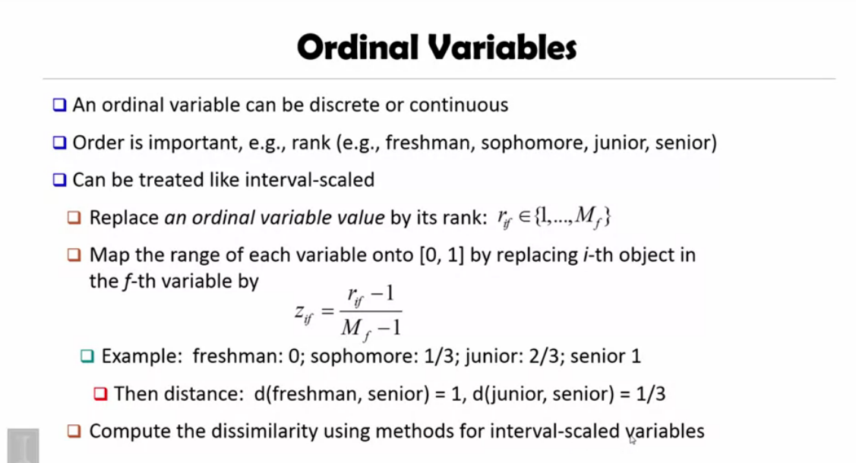

Slide 19
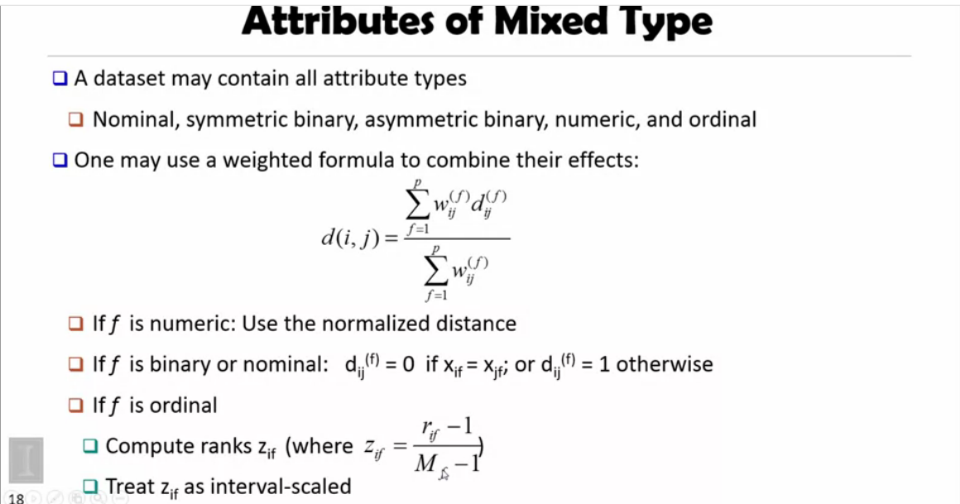

Slide 20
LOOK-ALIKE MODELING

Slide 21

RETO 1: TIEMPO DE EJECUCIÓN

Slide 22
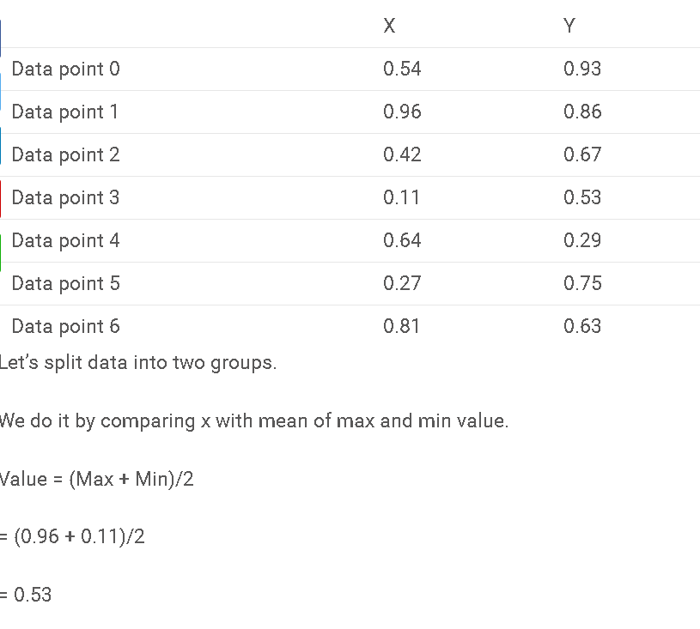
RETO 1: TIEMPO DE EJECUCIÓN (KD-TREE) [distancias metricas]
https://www.analyticsvidhya.com/blog/2017/11/information-retrieval-using-kdtree/

Slide 23
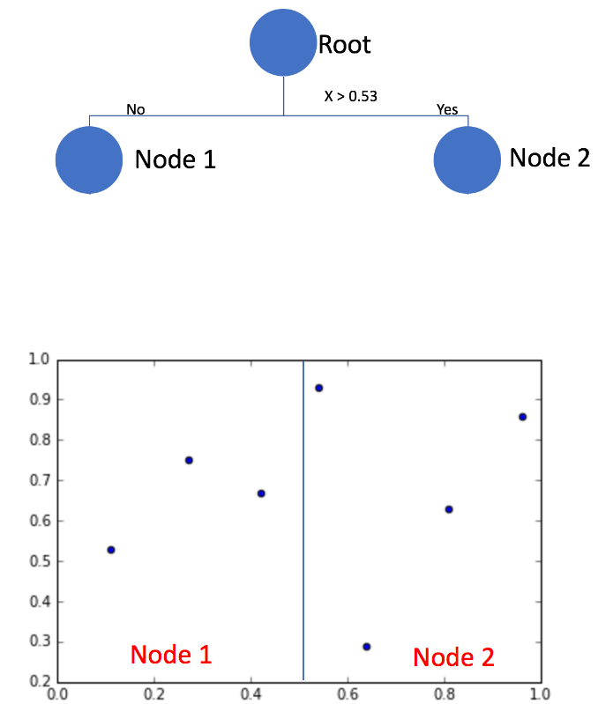
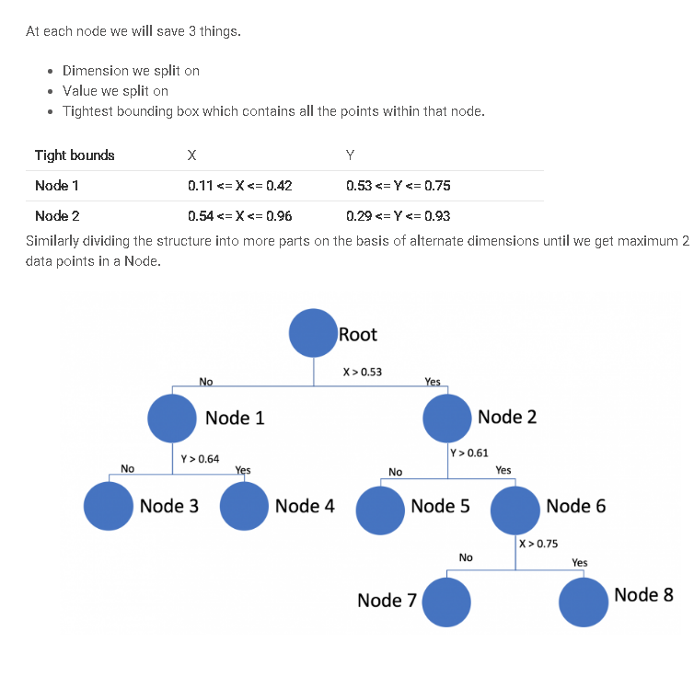
RETO 1: TIEMPO DE EJECUCIÓN

Slide 24
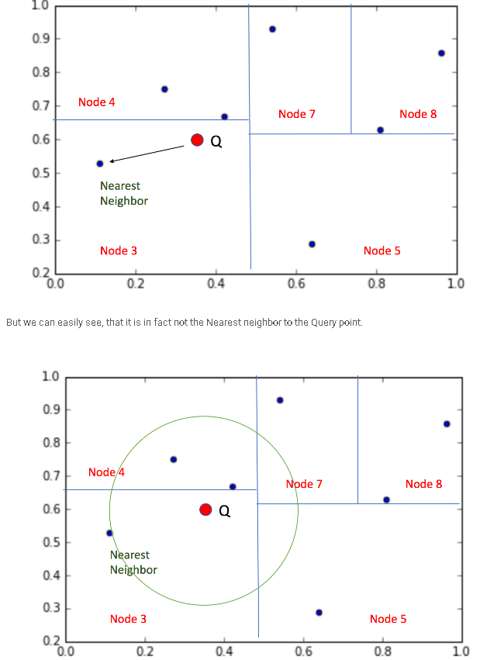
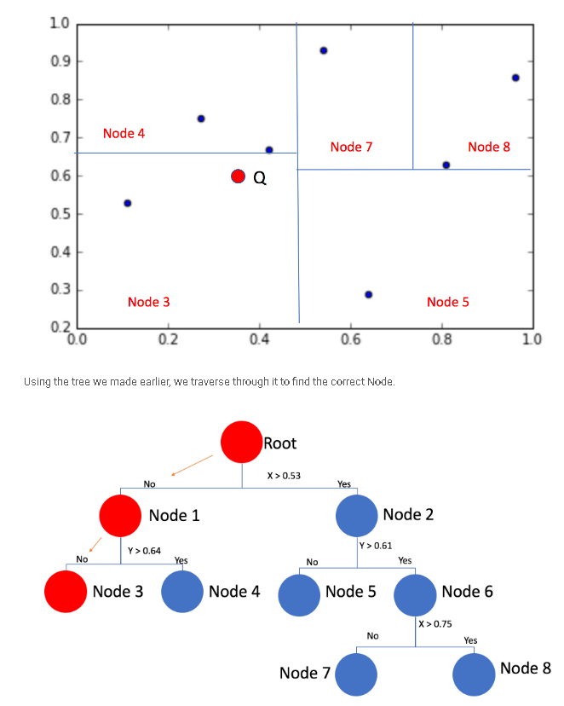
RETO 1: TIEMPO DE EJECUCIÓN

Slide 25
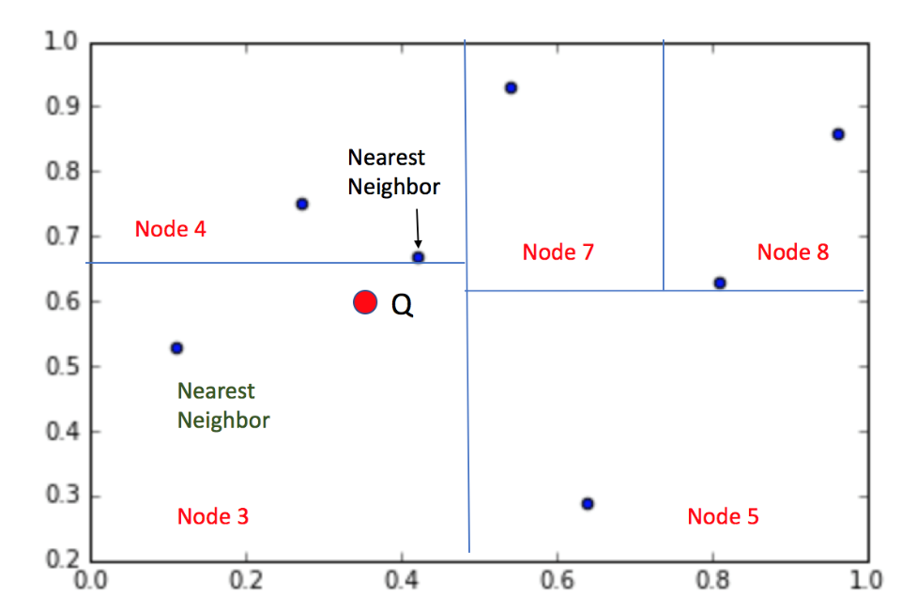
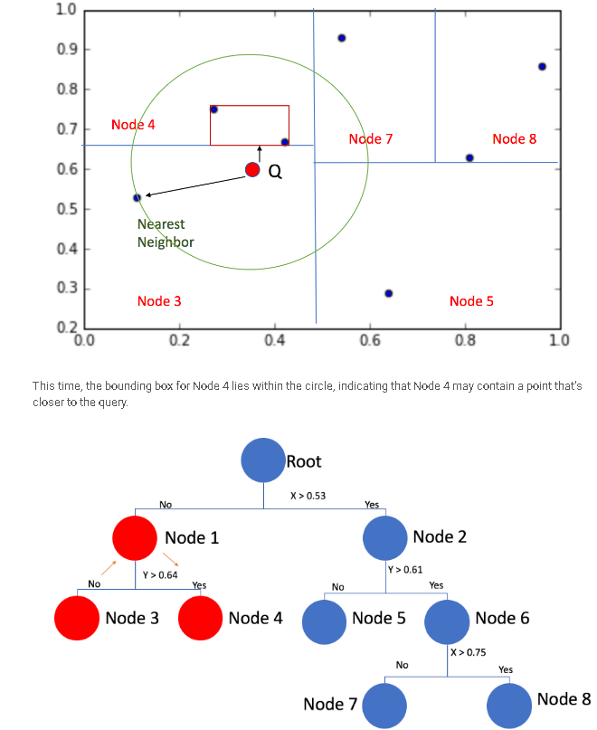
RETO 1: TIEMPO DE EJECUCIÓN

Slide 26
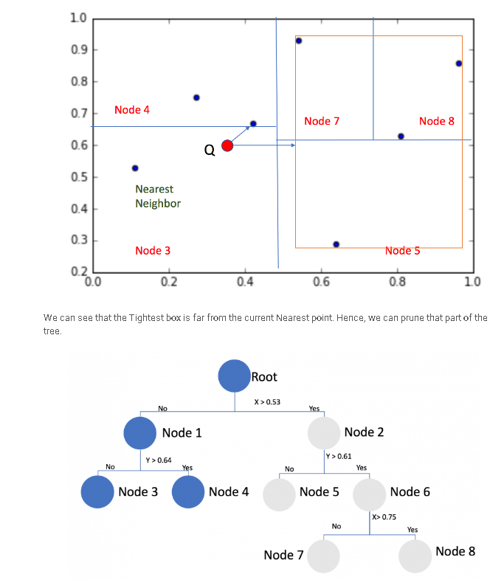
RETO 1: TIEMPO DE EJECUCIÓN

Slide 27
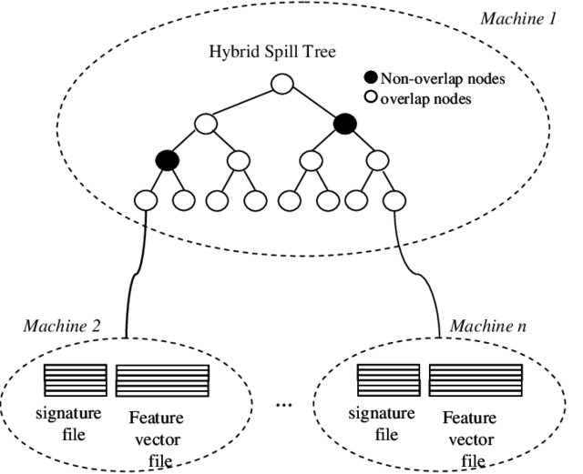
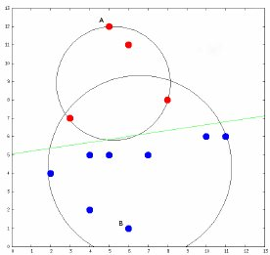
RETO 1: TIEMPO DE EJECUCIÓN
Ball-trees
Spill-trees

Slide 28
RETO 1: TIEMPO DE EJECUCIÓN
¿ANN?
APPROXIMATE NEAREST NEIGHBORS

Slide 29
RETO 1: TIEMPO DE EJECUCIÓN (LSH)
Locality Sensitive Hashing
Locality Sensitive Hashing (LSH) is a generic hashing technique that aims, as the name suggests, to preserve the local relations of the data while significantly reducing the dimensionality of the dataset
A hash function h is Locality Sensitive if for given two points a, b in a high dimensional feature space, 1. Pr(h(a) == h(b)) is high if a and b are near 2. Pr(h(a) == h(b)) is low if a and b are far 3. Time complexity to identify close objects is sub-linear.
https://towardsdatascience.com/locality-sensitive-hashing-for-music-search-f2f1940ace23

Slide 30
RETO 1: TIEMPO DE EJECUCIÓN (LSH)
Implementaciones:
Min-wise independent permutations
Nilsimsa Hash (Anti-Spam focused)
TLSH (For security and digital forensic applications)
Random Projection aka SimHash

Slide 31
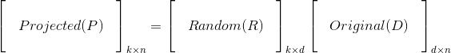
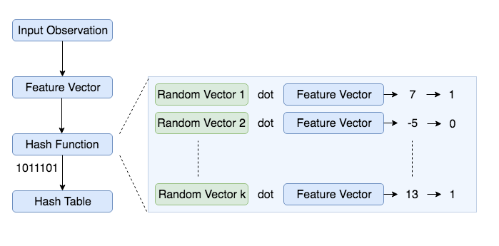
RETO 1: TIEMPO DE EJECUCIÓN (LSH- Random projection)

Slide 32
LOOK-ALIKE MODELING

Slide 33
RETO 2: ?
Tolerancia al ruido

Slide 34
RETO 2: TOLERANCIA AL RUIDO (KNN,MKNN)

Slide 35
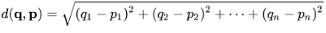
RETO 2: TOLERANCIA AL RUIDO (Scoring)
Average distance of every universe row to the seed set
Universe instance | Score (average distance)
1-46207750 | 45
1-98456714 | 12
.
.
1-77415523 | 7
Seed users
Universe
Ref: MA, Qiang, et al. Score Look-Alike Audiences. En Data Mining Workshops (ICDMW),
2016 IEEE 16th International Conference on. IEEE, 2016. p. 647-654.

Slide 36
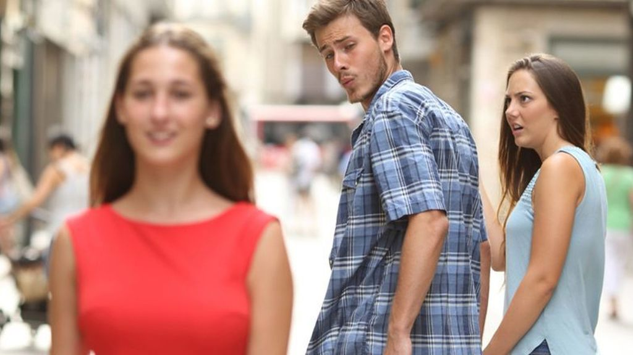
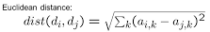
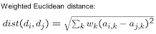
RETO 3: ?
Peso de variables

Slide 37
RETO 3: PESO DE VARIABLES
Grupo de variables
Propagación de pesos
VAR_GROUP | WEIGHT
SALDOS | 1000
LINEA_TARJ | 500
CREDIT_INI | 300
LABORAL | 800
UBIGEO | 500
INTERPERSONAL | 500
VAR_NAME | WEIGHT | VAR_GROUP
FLAG_RUC | 400 | LABORAL
FLAG_INGRESO | 400 | LABORAL
DISTRITO | 500 | UBIGEO
FLAG_CASADO | 166.6667 | INTERPERSONAL
FLAG_SOLTERO | 166.6667 | INTERPERSONAL
FLAG_POSCASADO | 166.6667 | INTERPERSONAL

Slide 38
Posibles mejoras
Metric learning
Scoring dinámico
Grafos
Hibridación con modelos supervisados

Slide 39
LOOK-ALIKE MODELING

Slide 40


Slide 41


Slide 42


